Slide 1
Natural Language Processing
Lecture 3: Regex
Dr. M. Taimoor Khan

Slide 2
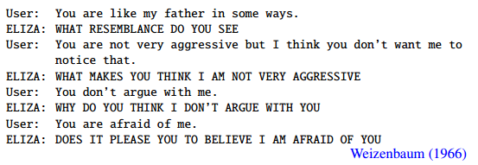
ELIZA (The psychologist)

Slide 3
Regex
Regular expressions are used to search and modify strings from documents. For example transforming,
“I am X” to “Why you think I am X”
Regular expressions helps to represent finite rules of a language from which infinite sentences can be created.

Slide 4
Regular Expressions (Applications)
Chatbots
Text normalization
Tokenization
Lemmatization
Stemming
Segmentation
Grammar correction
Sentences generation
…

Slide 5
Tokenization:
Identifying the language units (words)
E.g., White spaces
Lemmatization:
Determining that the two words are having the same root, despite their surface differences
E.g., song, sung, sang etc.
Stemming:
Striping suffixes from the end of a word e.g., identify, identification, identifiable, identifying
Segmentation:
Separation of units into groups e.g., sentence or paragraph

Slide 6
Regular Expression
A very important tool in NLP.
An algebraic expression (notation) for characterizing a set of strings.
Particularly helpful in searching text patterns in a corpus.
The search may be defined differently e.g., return all matches, first match, last match etc.
The mathematical structure of regex is almost the same, however, differently supported in various languages

Slide 7
Basic Regex Patterns
‘cake’:
May consist of a character or a character sequence
Regular expressions are case sensitive
Anyone from list []:
At least one character from the list given in []
E.g., ‘[cC]ake’
Or ‘[abc]d’ – any character from ‘abc’ and then d
‘[0123456789].00’ – any digit and then .00

Slide 8
Search Queries
Shortened Sequence (-):
When all the characters are in a sequence use -, as [a-z], [A-Z],[0-9]
Caret (^):
[^apt] i.e., any character other than a, p or t
[^a-z] i.e., any character other than small case character
Has to be the first character otherwise taken as caret
[e^] i.e., either e or ^
a^b i.e., sequence a^b

Slide 9
Optional characters (?):
colou?r i.e., color with or without u
Books? i.e., book or books
Kleene *:
We may generally need more than one character of a character
Means zero or one or many number of the immediately previous character
E.g., baa* i.e., can have any number of a’s at the end

Slide 10
a*:
Pakistan
baaaaaaaa
Cricket
[ab]*:
We may need to repeat complex combinations
E.g., ababab or abbbbb or bbbbbb or aaaaa etc.
[1-9][0-9]* i.e., price for something that may be 1 or more

Slide 11
Kleene +:
Any number of characters but atleast 1 e.g., price [1-9]+
Wildcard (.):
beg.n i.e., having any single character after g and before n
aardvark.*aardvark:
Looking for two occurrences of the same word (aardvark)

Slide 12
Anchors:
They anchor regular expressions to a particular places in a string
Caret (^) suggests the start of a line e.g., ^The indicates words starting with The
Dollar ($) suggest the end of a line e.g., The dog\.$ indicates the line ending with period
Boundary (b) limits the before or after characters e.g., \bther\b means the and not other or their etc.
It helps you define your language with a set of rules for example \b99\b means that 99 is a word but not 299!

Slide 13
Disjunction |:
Sometimes we would want one piece of string or another, and is specified as cat | dog i.e., having cat or dog
Grouping and precedence:
Using disjunction along with other strings we may want one or other form of it. It can be grouped with different character sequences using () e.g., if we want either guppy or guppies we can write gupp(y | ies)

Slide 14
Referring to an earlier occurrence of instance
the (.*)er they were, the \1er they will be
\1 referring to what is used in the paranthesis
Multiple capture groups
/the (.*)er they (.*), the \1er we \2/
\1 refers to what has occurred in the first group, while \2 refers to what has occurred in the second group

Slide 15
Exercise
It certainly was the thing I was looking for. It has aesthetic appearance and is very subtle at controlling different channels. The other thing I appreciate about it is its themes the_app and the255.
the
[tT]he
\b[tT]he\b
[ˆa-zA-Z][tT]he[ˆa-zA-Z]
(ˆ|[ˆa-zA-Z])[tT]he([ˆa-zA-Z]|$)

Slide 16
Another Exercise (price)
$[0-9]+
$[0-9]+\.[0-9][0-9]
(ˆ|\W)$[0-9]+(\.[0-9][0-9])?\b
(ˆ|\W)$[0-9]{0,3}(\.[0-9][0-9])?\b
\b[6-9]+ *(GHz|[Gg]igahertz)\b
\b[0-9]+(\.[0-9]+)? *(GB|[Gg]igabytes?)\b

Slide 17
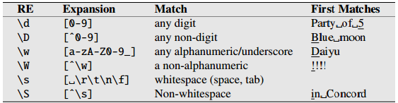
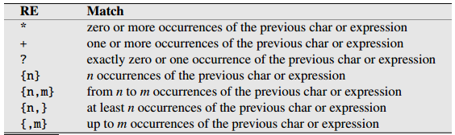
Other operators

Slide 18
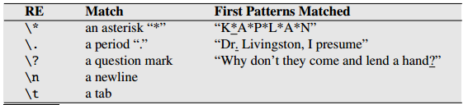

Slide 19
Substitution Queries
Python has the substitution operator s/regex/pattern
For example, s/colour/color
Change all instances of colour to color
Find all numbers in the file and enclose them in angular brackets
s/([0-9]+)/<\1>/
\1 refers to the instance of the brackets

Slide 20

Substitution and Capture
Helps to build simple chatbots
It can be clearly seen that some of the sentences are parsed and their pronouns are substituted

Slide 21
Python Regex
Import the re module
re functions
Function | Description | Description
findall | (pattern, string, flag=0) | Returns a list containing all matches
search | (pattern, string, flag=0) | Returns a Match object if there is a match anywhere in the string
split | (pattern, string, flag=0) | Returns a list where the string has been split at each match
sub | (pattern, string, flag=0) | Replaces one or many matches with a string

Slide 22
Example
Search
Findall
import re txt = "The rain in Spain" x = re.search("^The.*Spain$", txt)
print(x)
import re str = "The rain in Spain" x = re.findall("ai", str) print(x)

Slide 23
Split
Sub
import re str = "The rain in Spain" x = re.split("\s", str) print(x)
import re str = "The rain in Spain" x = re.sub("\s", "9", str) print(x)

